Slide 1

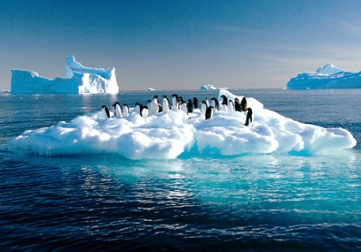
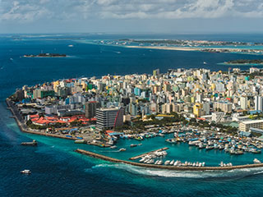
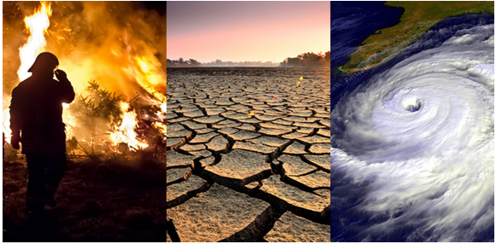
Environment and climate change statistics
“The role of the Global Set of Climate Change Statistics and Indicators in helping countries measure and monitor progress toward Net-Zero”
21 August 2025

Slide 2
Outline
Background and UNFCCC
UN Mandates and frameworks
Implementation support
  4. Next steps

Slide 3
United Nations Framework Convention on Climate Change
NDC, ETF and GST under the Paris Agreement
Accounting and tracking progress of NDCs
Implementation
Preparation
and communication
Reporting (BTRs)
NDCs
ETF
Every 5 years
Review
1
2
Consideration of outputs
Technical assessment
GST
3
Information collection
Notes:
Climate policies meet statistics in the following key processes: on international level - building an enhanced transparency framework, promoting compliance and running a global stocktake every 5 years. On national level – planning: via NDC, nationally determined contributions, national adaptation plans, finance. This is already ongoing for several years, many countries have defined and updated processes. Currently is running the first cycle of submission of the Biennial Transparency Reports, for which I am excited to ensure that this workshop can contribute. Why, because this is the tool to illustrate what the country needs and enhance the access to climate finance

Slide 4
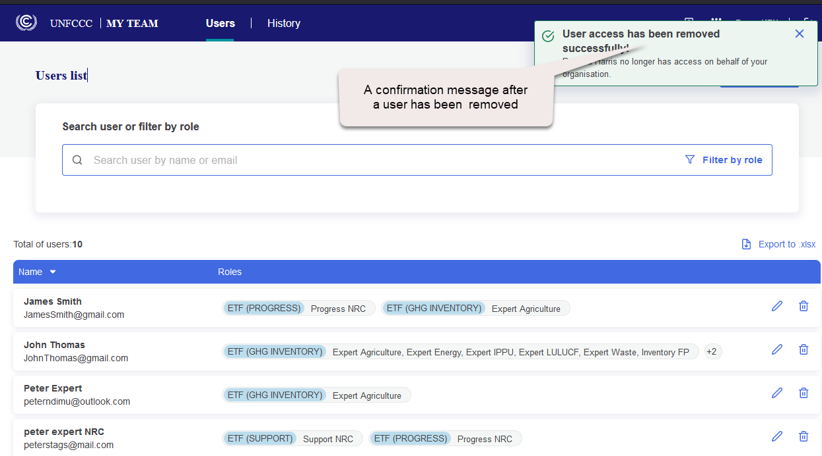




ETF Reporting Tools - released on 28 June 2024
GHG inventory
User management tool
ETF reporting tools
Progress
User manuals
ETF GHG inventory reporting tool
ETF Progress reporting tool
ETF Support reporting tool
User management tool
Support

Slide 5
Can climate change statistics support countries on their journey to achieve Net Zero?
According to the Intergovernmental Panel on Climate Change (IPCC), net zero emissions are achieved when anthropogenic emissions of greenhouse gases to the atmosphere are balanced by anthropogenic removals over a specified period. Climate change mitigation policies and actions are typically designed to reduce greenhouse gas (GHG) emissions to the atmosphere or to remove them from the atmosphere e.g. by carbon sequestration. CO₂ emissions are the largest GHG by volume and the only GHG which can be removed by the ecosystems and the oceans.
The Biennial Transparency Report (BTR) is the instrument for all Parties to report their actions/endeavors in fighting climate change under the Paris Agreement in a comparable manner. The Global Stocktake in three years from now will show a snapshot of the current situation based on the available information provided by Parties of the Paris Agreement. Glossary — Global Warming of 1.5 ºC

Slide 6


Background and process:
Collaboration between UNSD, UNFCCC and the Expert Group on Environment and Climate Change Statistics
Mandate by 47th session of Stat. Commission to UNSD for Global Set
Request by 49th session of
Stat. Comm. to UNSD and UNFCCC to strengthen link between statistics and policy
SG Report on CC Statistics to SC (information)
SG report on CC Statistics to SC (decision)
SG report on CC Statistics to SC (decision)
2008
2009
COVID….
2022
2024
2017/2018
2020
2021
2025
UNSD confer-
ences
on climate change and official stats (Oslo and Seoul)
Report by the ABS to the 40th session of Statistical Commission
2016
UNSD Pilot Testing of ECE set of indicators
2018
Launch and Analysis of Pilot Survey
Revision of
draft Global Set of Statistics and
indicators
Global
Consultation
Adoption
Implementation
UNSD programme on climate change statistics supports countries with less developed statistical systems to start and advance work in this area, special attention to SIDS and least developed countries, guidance tailored to their needs.
Notes:
The process started before the Paris Agreement and it is taking about 15 years. UNSD prepared 5 reports to the Statistical Commission: in 2016, it received a mandate to develop a global set; in 2018 the message was to strengthen the link between policy and statistics via joint work with UNFCCC. In 2022, a fourth report was submitted which presented the Global Set and led to its adoption, and this year (2024) – the report focused on its implementation.
The Expert Group on Environment Statistics was renamed to be the Expert Group on Environment and Climate Change Statistics given the increased focus on climate change statistics.

Slide 7
Background and process:
Collaboration between UNSD, UNFCCC and the Expert Group on Environment and Climate Change Statistics
Decisions of the Statistical Commission:
Decision 47/112 (2016), UNSD requested to develop a global set of climate change statistics and indicators, applicable to countries at various stages of development:
http://unstats.un.org/unsd/statcom/47th-session/documents/Report-on-the-47th-session-of-the-statistical-commission-E.pdf
Decision: 49/113 (2018), UNSD and UNFCCC to strengthen the link between statistics and policy:
https://unstats.un.org/unsd/statcom/49th-session/documents/Report-on-the-49th-session-E.pdf
Decision 53/116 (2022), the Global Set was adopted at the 53rd session of the Statistical Commission: https://unstats.un.org/unsd/statcom/53rd-session/documents/2022-41-FinalReport-E.pdf
Decision 55/118 (2024) focuses on implementation of the Global Set including investment in climate change statistics, use of administrative data, and including climate change questions in relevant censuses and surveys. : https://unstats.un.org/UNSDWebsite/statcom/session_55/documents/2024-36-FinalReport-E.pdf
Decision 56/124 (2025) the Commission supported the restructuring of the expert group based on its expanded scope of work covering environment and climate change statistics: https://unstats.un.org/UNSDWebsite/statcom/session_56/documents/2025-37-FinalReport-EE.pdf.

Slide 8
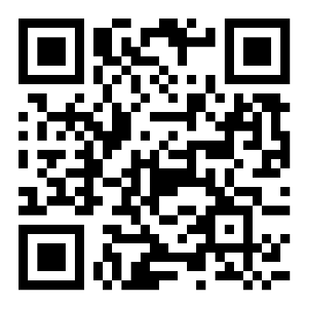
Background and process on Data collection (water and waste)
Since 1999, UNSD has completed 11 data collections on water and waste statistics (usually biennially) from about 160-170 UN member states. Mandated by the UNSC (Para. 77 (1995)); and reinforced by the UNSC (Chapter IV, Para. 2 (2003)). https://unstats.un.org/UNSDWebsite/statcom/session_28/documents/statcom-1995-28th-report-E.pdf https://unstats.un.org/UNSDWebsite/statcom/session_34/documents/statcom-2003-34th-report-E.pdf
This session, the Statistical Commission is, inter alia, invited:
to urge countries to strengthen national data collection and compilation in environment and climate change statistics to better inform policy decisions and to facilitate unified reporting for international data requirements, and encourage countries to promote a coordinated response when completing the Statistics Division/UNEP questionnaire on environment statistics
https://unstats.un.org/UNSDWebsite/statcom/session_56/documents/2025-25-EnvironmentStats-E.pdf

Slide 9
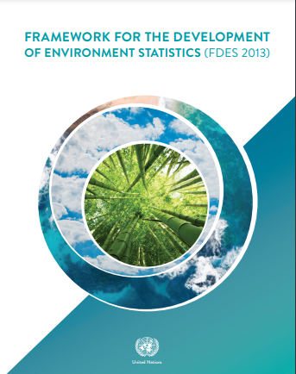
Framework for the Development of Environment Statistics (FDES 2013)
1. The UN Statistical Commission endorsed the revised FDES 2013 at its 44th session in 2013 as the framework for strengthening environment statistics programmes in countries.
2. The objectives are:
  Help international and regional institutions to support strengthening capacity in countries to develop environment statistics
  Enhance comparability and availability of environment statistics using a common framework
  Better inform policy making decisions
3. Implementation supports tools:
  Environment Statistics Self-Assessment Tool (ESSAT)
  Manual on the Basic Set of Environment Statistics
  SDG indicators + Basic Set (FDES) matrix
Chapter 5 provides a cross-cutting analysis of climate change, and methodology guidance is provided for GHG emissions
Download FDES 2013 at https://unstats.un.org/unsd/envstats/fdes.cshtml.

Slide 10
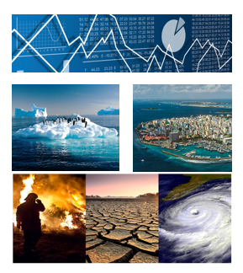
Global Set of Climate Change Statistics and Indicators
1. The Global Set was adopted at the 53rd session of the Statistical Commission (Decision 53/116 (2022)
2. Contains 158 indicators (and 190 statistics) which link policy targets (drivers, impacts, vulnerability, mitigation, adaptation) and statistical indicator frameworks across:
  Paris Agreement
  Sendai Framework
  Sustainable Development Goals
3. The aim is to contribute to:
  independent national policies evaluation
  comparable reporting to UNFCCC
  advance of climate change and environment statistics
4. The Global Set helps to define the scope and content of:
  National programmes, countries use the Global Set to develop their own sets
  Regional approaches, indicators were adapted/selected by ECLAC and ESCWA
5. Helps to frame and steer:
  further methodology development in prioritized areas such as gender and health
  capacity development by UNSD, UNEP, Regional Commissions, CARICOM, COMESA

Slide 11
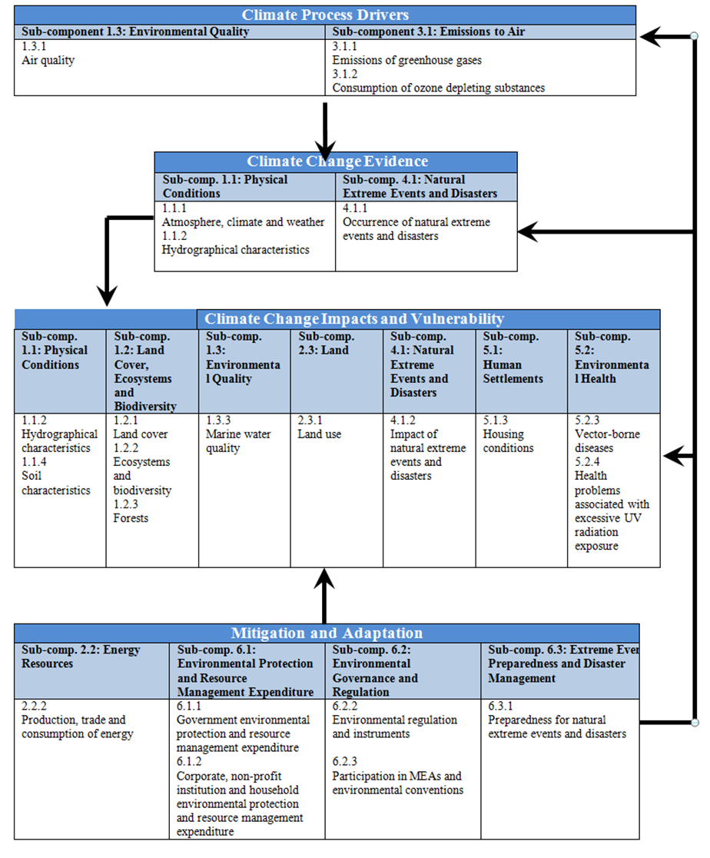
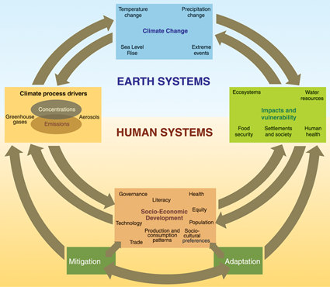
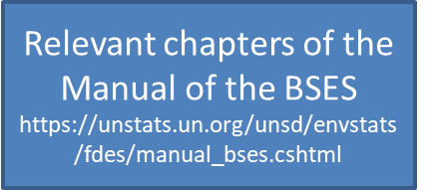
Methodological foundation
Given that there was no underlying framework linking the reporting requirements stemming from the Paris Agreement and the necessary statistics or indicators to support climate policy action, UNSD worked closely with UNFCCC to develop such a framework explicitly for climate change.
The Global Set, developed in close collaboration with UNFCCC, is structured according to the IPCC framework and FDES, with a tiering system as in the FDES and the SDG indicators.
Framework for the Development of Environment Statistics (FDES 2013)
IPCC, 2007, Fourth Assessment Report
FDES cross-cutting application (Chapter 5) links climate change and environment statistics based on the IPCC Framework
Notes:
Since there was no framework to link the reporting requirements under the Paris agreement with the needed official statistics, UNSD and UNFCCC prepared the Global Set based on the five IPCC areas and the FDES (chapter 5) with a tiering system as in the FDES and the SDG indicators. The Global Set also provides the links to the SDG and Sendai indicators.
5 areas of the IPCC framework - drivers, impacts, vulnerability, mitigation and vulnerability.
Components, sub-components and topics of the FDES and Chapter 5: cross cutting issues, e.g. climate change
References to international agreements and frameworks:
- relevant articles of the Paris Agreement and the Katowice Package are mentioned for each indicator thereby clearly demonstrating the link between statistics and policy.
- SDGs, FDES and Sendai Framework have been considered to promote consistency and harmonize the wording of the indicators to the extent possible.
Criteria for selection of indicators:
- Consistency with existing thematic indicator sets and guidance, namely from UNFCCC/IPCC, FAO, SDGs, UNDRR, UNCCD, UNCBD, as well as with the FDES statistics, has been promoted.
- Complementarity with existing regional climate change indicators, e.g. CARICOM, ESCWA, EEA, UN-ECE, and Eurostat, where applicable, as well as other relevant initiatives.
- Indicators for which metadata can be developed.
Since there was no framework to link the reporting requirements under the Paris Agreement with the needed official statistics, UNSD and UNFCCC prepared the Global Set based on the five IPCC areas and the Framework for the Development of Environment Statistics or the FDES. It should be noted that the FDES was adopted by the Statistical Commission in 2013 as the framework for strengthening environment statistics programmes in countries and that it already contained a selection of climate change statistics as a cross-cutting theme in Chapter 5. The Global Set also provides the links to the SDG and Sendai indicators.

Slide 12
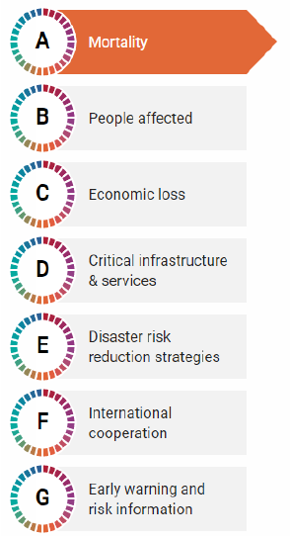

Connections with indicators from:
The Sendai Framework
2030 Agenda for Sustainable Development
2 | 3 | 1 |  | 1 | 6
5 |  | 1 |  | 5 | 3
6 | 3 | 6
Notes:
The Paris Agreement is in synergy with other international agreements, most of all the Sendai Framework and the 2030 Agenda for Sustainable Development, and the indicators sets under these agreements are well aligned. Therefore, it should not be a surprise that any statistical advance on national level, either on the disaster indicators under the Sendai Framework or the following SDG indicators would contribute to advancing a national programme on climate change statistics. The counts on the SDGs shows you how many indicators from the respective goal were included in the Global Set, either in verbatim or slightly modified way. Modifications were needed to make indicators designed for international use, such as number of countries doing something, to national.

Slide 13
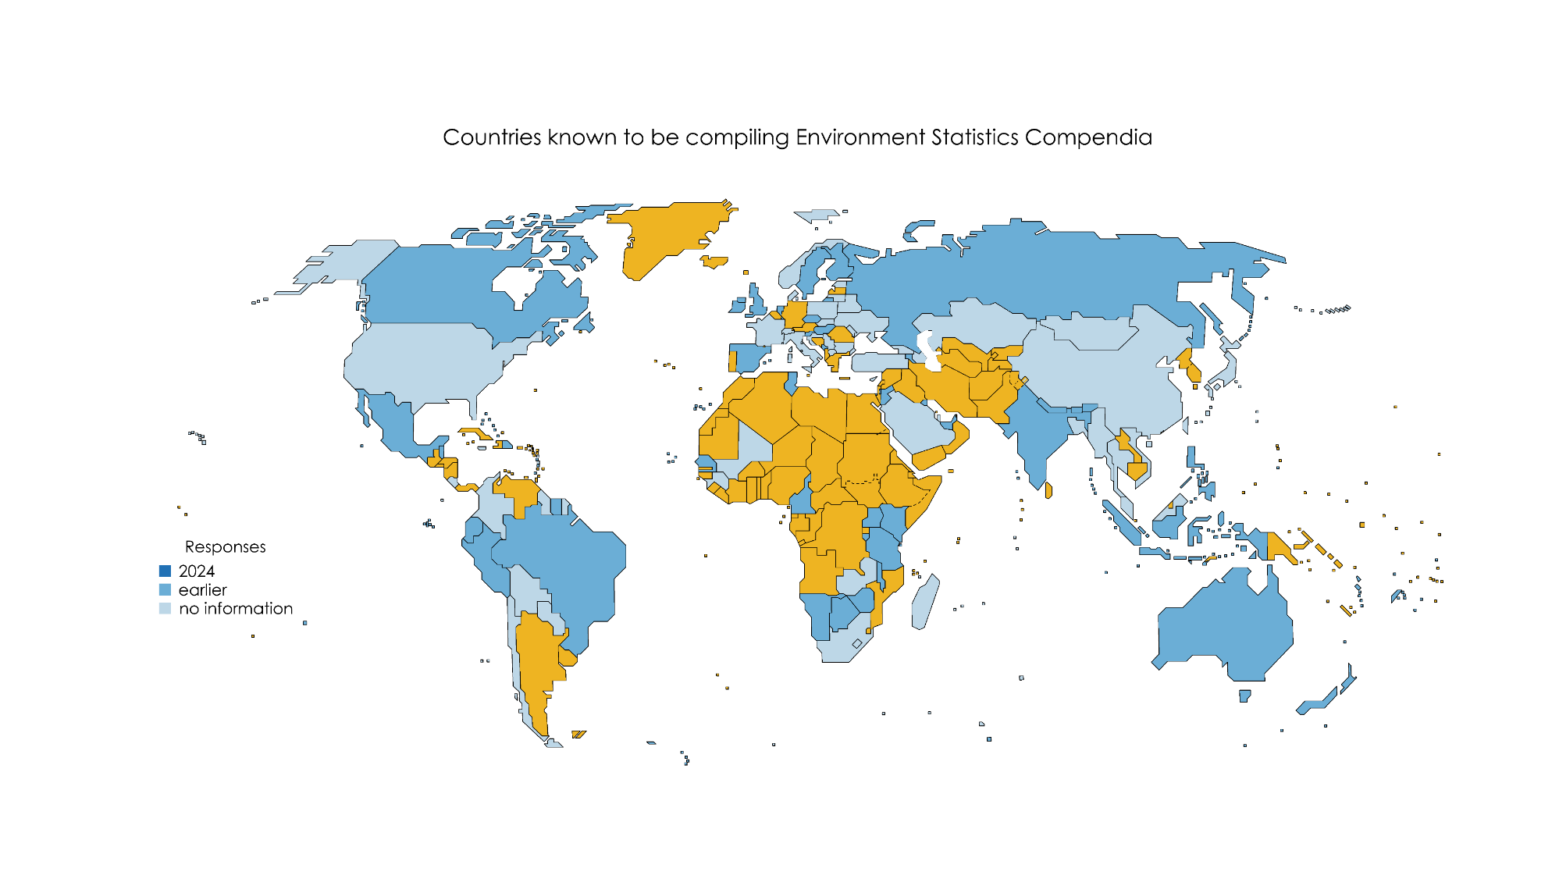
Growing engagement of countries and responses to surveys in 2024
(98 out 215 countries and territories)
2024
Earlier
No information
The boundaries shown and used on this map do not imply official endorsement or acceptance by the United Nations.
Notes:
Orange is no information, lightest blue is from the responses to the global consultation, mid blue is from 2023 and darker 2024

Slide 14
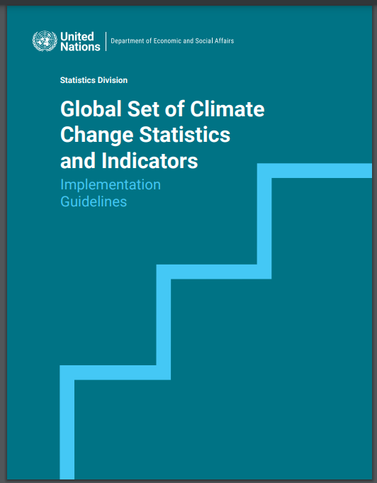
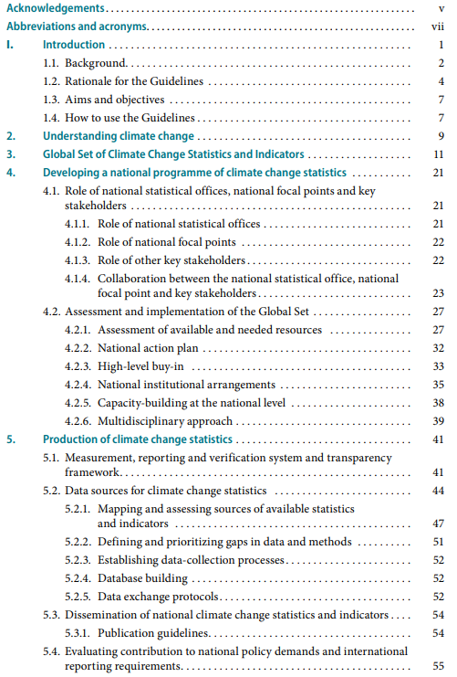
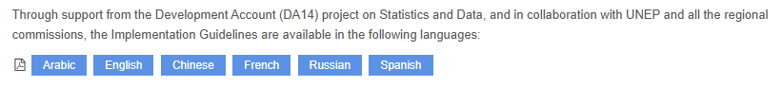
https://unstats.un.org/unsd/envstats/climate%20change/implementation_guidelines.cshtml
Notes:
In relation to this last point, we have published short implementation guidelines which recommend the key actions for both NSO and focal points to UNFCCC to do in collaborative manner, because in the absence of such collaboration we believe that either side will have to duplicate certain activities. The guidelines were officially translated into the 6 UN official languages and can be obtained here.

Slide 15
Climate Change Statistics and Indicators Self-Assessment Tool (CISAT)
UNSD, in collaboration with the United Nations Framework Convention on Climate Change (UNFCCC) and the Expert Group on Environment Statistics (EGES), has developed the Climate Change Statistics and Indicators Self-Assessment Tool (CISAT) to support the implementation of the Global Set of Climate Change Statistics and Indicators. The CISAT gives United Nations Member States an opportunity to undertake a thorough and detailed assessment of the statistics and indicators in the Global Set which will allow the country to prioritize the nationally relevant indicators and statistics.
Introduction
Part I: Institutional Dimensions of Climate Change Statistics and Indicators
Part II: Statistics and Indicators Assessment
Instructions for Part II
Global Set of Climate Change Statistics and Indicators *
Metadata *
* Each indicator in the Excel file is linked with its metadata in the Word file via hyperlinks. Both the Excel and the Word files need to be downloaded and saved in the same folder for this feature to work; also the name of the Word file should not be changed.
https://unstats.un.org/unsd/envstats/Climate%20Change/cisat.cshtml
Notes:
I’ll just highlight that we have this self assessment tool for Climate Change Statistics and Indicators that has all the full detail on the global set including its metadata, it’s intended to be the place for updates

Slide 16
Indicators on GHG emissions and removals in the Global Set
The Global Set of Climate Change Statistics and Indicators offers 12 indicators addressing GHG emissions and removals structured in the areas of drivers and mitigation, namely:
Total greenhouse gas emissions per year (Tier 1);
Total emissions of indirect greenhouse gases (Tier 1);
Greenhouse gas emissions from land use, land use change and forestry (Tier 1);
Total greenhouse gas emissions from the national economy (Tier 2);
Greenhouse gas emissions per capita (Tier 1);
Greenhouse gas emissions in gross fixed capital formation of direct investment (Tier 3);
Greenhouse gas emissions in value added of foreign controlled multinational enterprises (Tier 3);
Carbon footprint (Tier 2);
Greenhouse gas intensity of the economy (including transport) (Tier 2);
Rate of decrease of greenhouse gas emissions per unit of gross domestic product (Tier 1);
Greenhouse gas removals (carbon sequestration) (Tier 2),
Progress towards achieving the nationally determined contribution (Tier 3).

Slide 17
Indicators on GHG emissions and removals in the Global Set
Indicator | Tier | Method
Total greenhouse gas emissions per year (DRIVERS) | 1 | IPCC; SDG
Total emissions of indirect greenhouse gases | 1 | IPCC; FDES
Greenhouse gas emissions from land use, land use change and forestry | 1 | IPCC; FDES
Total greenhouse gas emissions from the national economy | 2 | SEEA-CF
Greenhouse gas emissions per capita | 1 | IPCC; FDES
Greenhouse gas emissions in gross fixed capital formation of direct investment | 3 | SEEA-CF
Greenhouse gas emissions in value added of foreign controlled multinational enterprises | 3 | SEEA-CF
Carbon footprint | 2 | SEEA-CF
Greenhouse gas intensity of the economy (including transport) (MITIGATION) | 2 | SEEA-CF
Rate of decrease of greenhouse gas emissions per unit of gross domestic product | 1 | IPCC
Greenhouse gas removals (carbon sequestration) | 2 | IPCC; FDES; SEEA-EA
Progress towards achieving the nationally determined contribution | 3

Slide 18
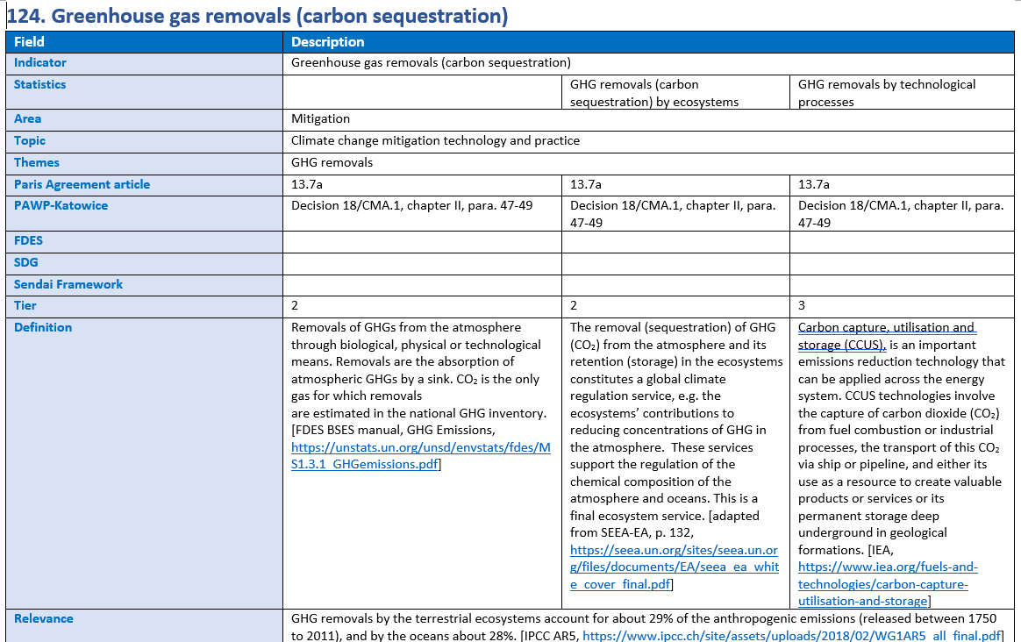
Global set, metadata [covers 26 fields]

Slide 19
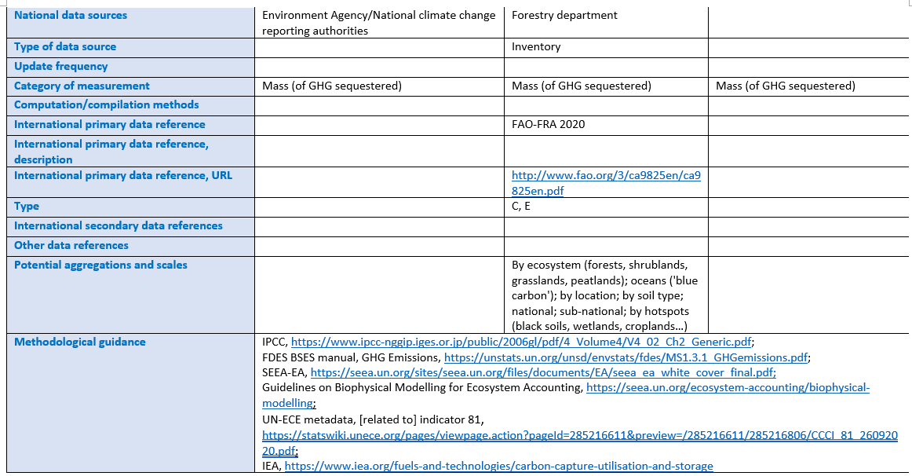
Global set, metadata [covers 26 fields]

Slide 20
Other indicators from the Global Set which may support Net Zero analysis
Indicator | Tier | Method
Intensity of use of forest resources (DRIVERS) | 2
Deforested area as a proportion of total forest area | 2
Forest area as a proportion of total land area (IMPACTS) | 1 | SDG; SEEA-CF
Reduction in the extent of natural and semi-natural ecosystems | 2 | SEEA-EA
Proportion of forest area affected by forest fires | 1
Phytosanitary status of forest | 3
Proportion of land that is degraded over total land area | 1 | SDG; UN-ECE
Impact on production of wood and non-wood products | 3
Ecosystem carbon stocks (VULNERABILITY) | 2 | SEEA-EA
Increase in forest area (MITIGATION) | 2 | SEEA-CF; FDES
Nature-based adaptation (ADAPTATION) | 3 | SEEA-EA
Proportion of important sites for terrestrial and freshwater biodiversity that are covered by protected areas, by ecosystem type | 1 | SDG
Proportion of degraded area of ecosystems that has been restored | 3 | SEEA-EA
Progress towards sustainable forest management | 1 | SDG; GBMF

Slide 21
Next steps
Related work:
Integrity Matters: Net-Zero Emissions Commitments of Non-State Entities: Integrity Matters: Net-Zero Emissions Commitments of Non-State Entities | United Nations
Which countries have already reached net zero emissions? | World Economic Forum
Key messages:
Official statistics as best tool to fight greenwash misinformation;
The Global Set helps by linking all the relevant statistical frameworks (also as tier 3 it offers indicators not yet in any framework);
The EG-ECCS can offer inputs into this process based on the experiences of about 40 countries taking part

Slide 22

Thank you for your attention!
For more information please contact the Environment Statistics Section
at the United Nations Statistics Division:
E-mail: envstats@un.org
Website: https://unstats.un.org/unsd/envstats/
Climate Change Statistics Website https://unstats.un.org/unsd/envstats/climatechange.cshtml
and
https://unstats.un.org/unsd/envstats/ClimateChange_StatAndInd_global.cshtml

Slide 23
Questions
1. How is the Global Set being applied in your country? How is it related to reporting to UNFCCC (e.g. NAPs, BTRs, etc.)?
2. Are you aware of discussion or official policy on ‘NetZero’ in your country?
3. Do you have experience with either the IPCC “territorial approach” for estimating GHG emissions or SEEA “residence approach”? If so, are you aware of how the statistics on GHG emissions are used in your country?
Notes:
National programs.

